Slide 1
In the Bible Jesus says ‘I am the way and the truth and the life. No one comes to the Father except through me’. John 14:6.
This message is a key part of the Easter story, that Jesus came to Earth to bring hope and to offer people a new way of living life and coming closer to God.
LENT
For the next six weeks we will go on a journey through Lent, thinking about on Jesus’ ministry and his example of being a “way maker” and serving others.

Slide 2
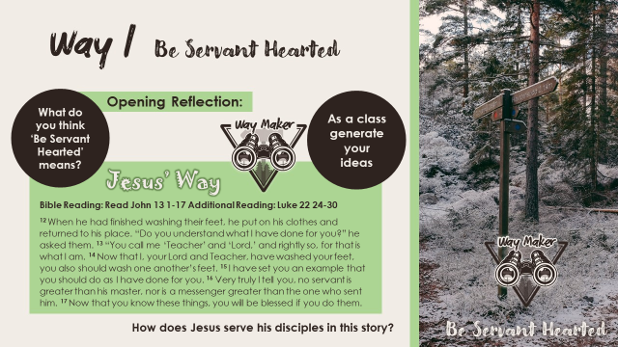

Slide 3
Be Servant Hearted ?
What does this mean?
We often think of the role of a servant as being low paid and having little value.
It is in fact the opposite. A servant meets the needs of others puts others needs before themselves

Slide 4
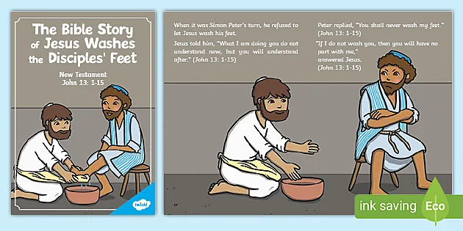
Jesus washes his disciples feet

Slide 5
Being Servant hearted
Its not about our position or our skills its about our attitude
How can we add value to other peoples lives.
Actions speak louder than words

Slide 6
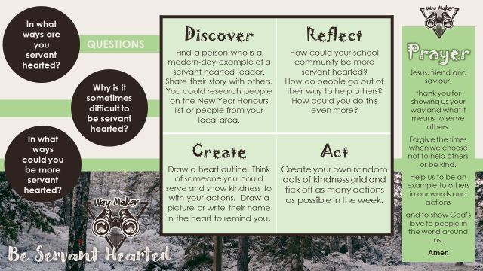

Slide 7
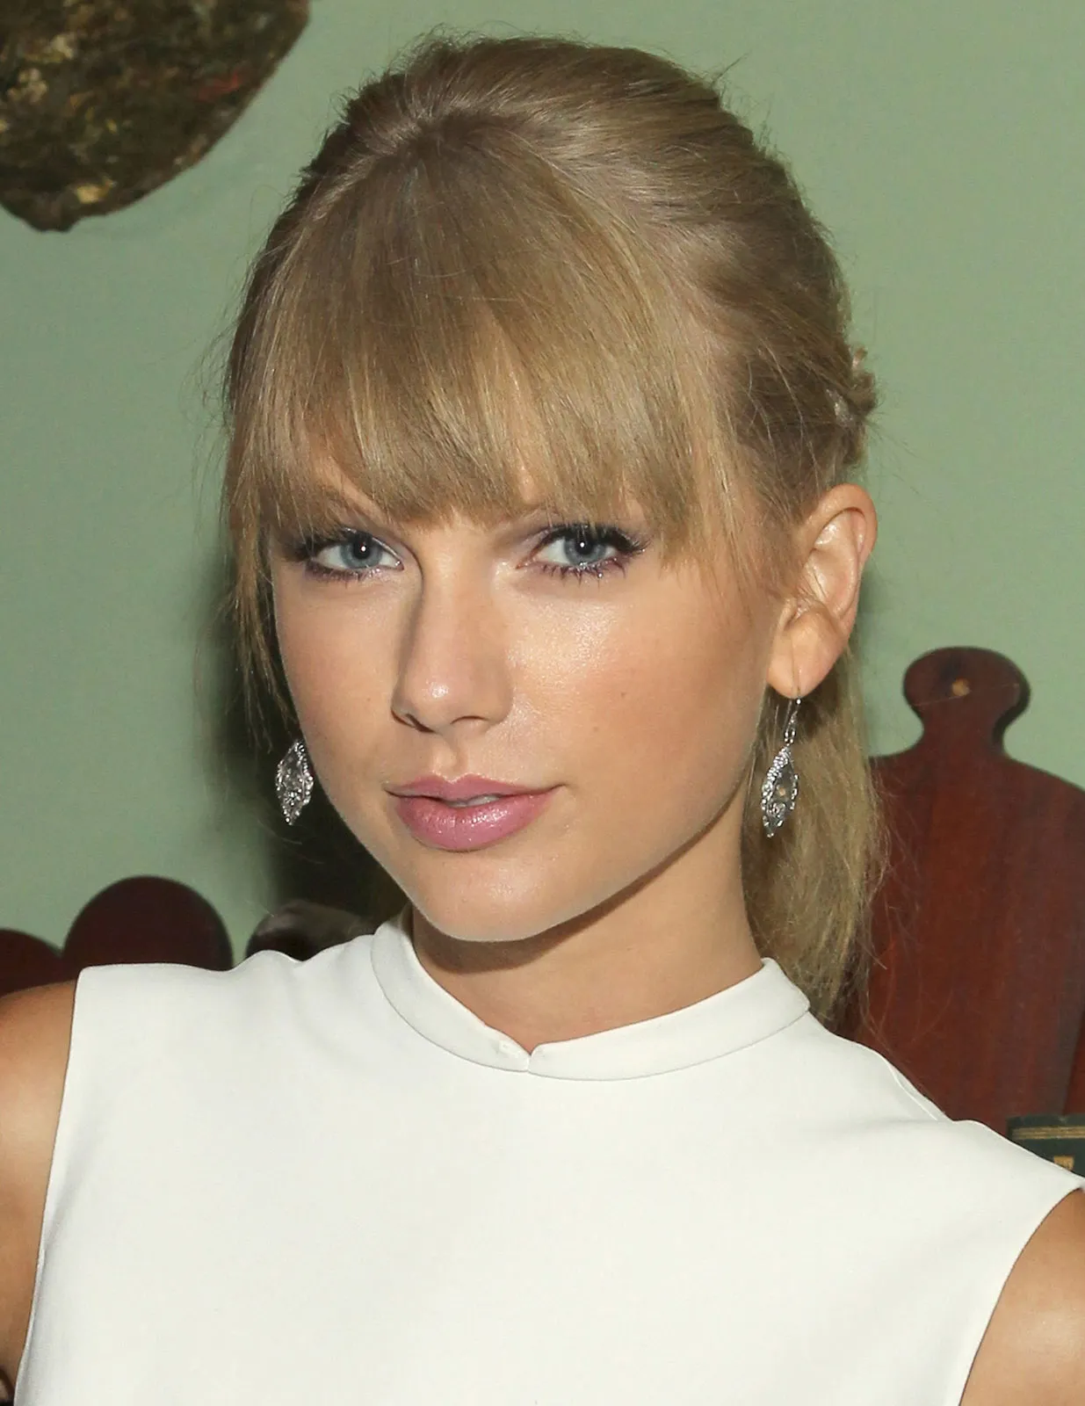
Taylor Swift
While on the road for her successful Eras Tour, Taylor Swift made significant contributions to several food banks in cities where she performed in the United States. She has also made donations to education, disaster relief, and child welfare organizations.

Slide 8
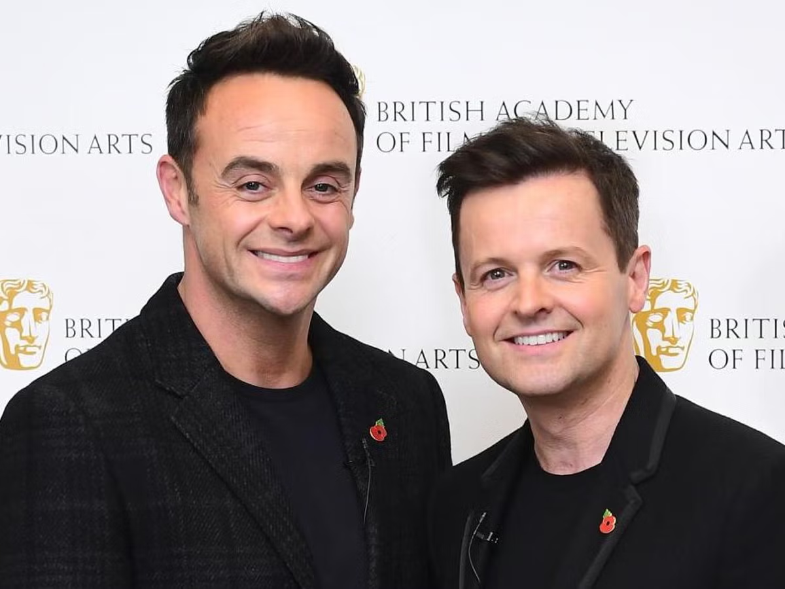
Ant n Dec
In 2021, Ant and Dec became Goodwill Ambassadors for The Prince’s Trust, partnering with them to help the next generation develop skills for the media industry and find jobs and training opportunities. Their new and unique programme is called Ant and Dec’s Making it in Media and the first course ran in London in July 2021, giving young people the opportunity to develop their self-confidence and practical skills alongside gaining industry knowledge from media experts.

Slide 9
Reflection
How do we as a school community be servant hearted to others?
How do people go out of their way to help others?
How could we do more?

Slide 10
LENT
Dear God,
Thank you for showing us your way, and what it means to serve others.
Forgive us the times we have been unkind to others in our words or actions.
Help us to be an example to others in our words and actions and to show God’s love to the people of the world around us.
Amen

Slide 11
