Slide 1
In the Bible Jesus says ‘I am the way and the truth and the life. No one comes to the Father except through me’. John 14:6.
This message is a key part of the Easter story, that Jesus came to Earth to bring hope and to offer people a new way of living life and coming closer to God.
LENT
For the next six weeks we will go on a journey through Lent, thinking about on Jesus’ ministry and his example of being a “way maker” and serving others.

Slide 2


Slide 3
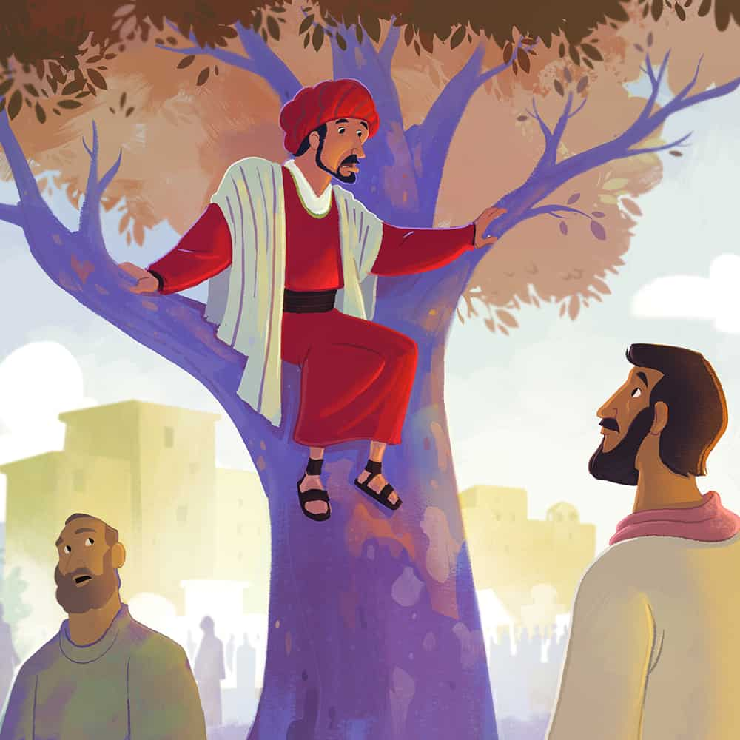
Zacchaeus the Tax Collector

Slide 4
Be Accepting
Be supportive to everyone show tolerance
Think about how we can show tolerance which is also one pf our British Values and acceptance of differences to everyone who is part of the Jarrow Cross family?
Think about a time when you have been accepting
How could you be more accepting in our everyday actions.
Actions speak louder than words

Slide 5


Slide 6
Reflection
Think about a time when you have been accepting to someone who is different to you.
How could you be more accepting in our everyday actions.

