Slide 1
In the Bible Jesus says ‘I am the way and the truth and the life. No one comes to the Father except through me’. John 14:6.
This message is a key part of the Easter story, that Jesus came to Earth to bring hope and to offer people a new way of living life and coming closer to God.
LENT
For the next six weeks we will go on a journey through Lent, thinking about on Jesus’ ministry and his example of being a “way maker” and serving others.

Slide 2


Slide 3

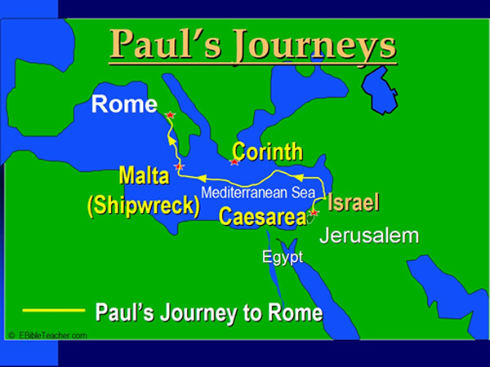
Paul’s journey to Rome

Slide 4
Paul had been arrested and was being sent to Rome for a trial. He warned the crew of the ship that it would be a very dangerous trip, but they didn’t listen to him and set sail anyway. There was a long storm, and they ran out of food. But Paul told them that an angel had appeared to him and said that no one would die, because Paul had to appear in Rome. The angel said, “Do not be afraid, Paul; you must stand before Caesar. And behold, God has granted you all those who sail with you.” So Paul told the men to have courage. He told them they would have shipwreck, but they would be safe.
Can you imagine how difficult it would be to encourage the people who were holding you captive? But Paul did that very thing, trusting in the Lord for the courage he needed.

Slide 5


Slide 6
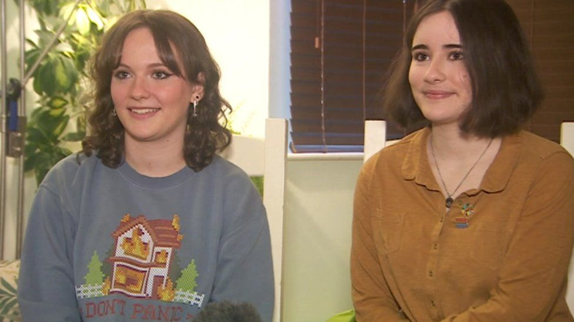
Amy and Ella Meek-Kids Against Plastic

Slide 7
Be Bold - Reflection
When have you been bold and stood up for something or someone
Why is it sometimes difficult to speak out?
What would help you to become bolder?
Actions speak louder than words

Slide 8
Prayer
Dear Prayer,
Thank you for encouraging us to be bold. Help us to stand up for what we believe is right and stand up against what is wrong.
Help us to be tempted to not do what we know is wrong.
Instead help us to have courage and use our words and actions in ways that shows God’s love.
Amen

