Slide 1
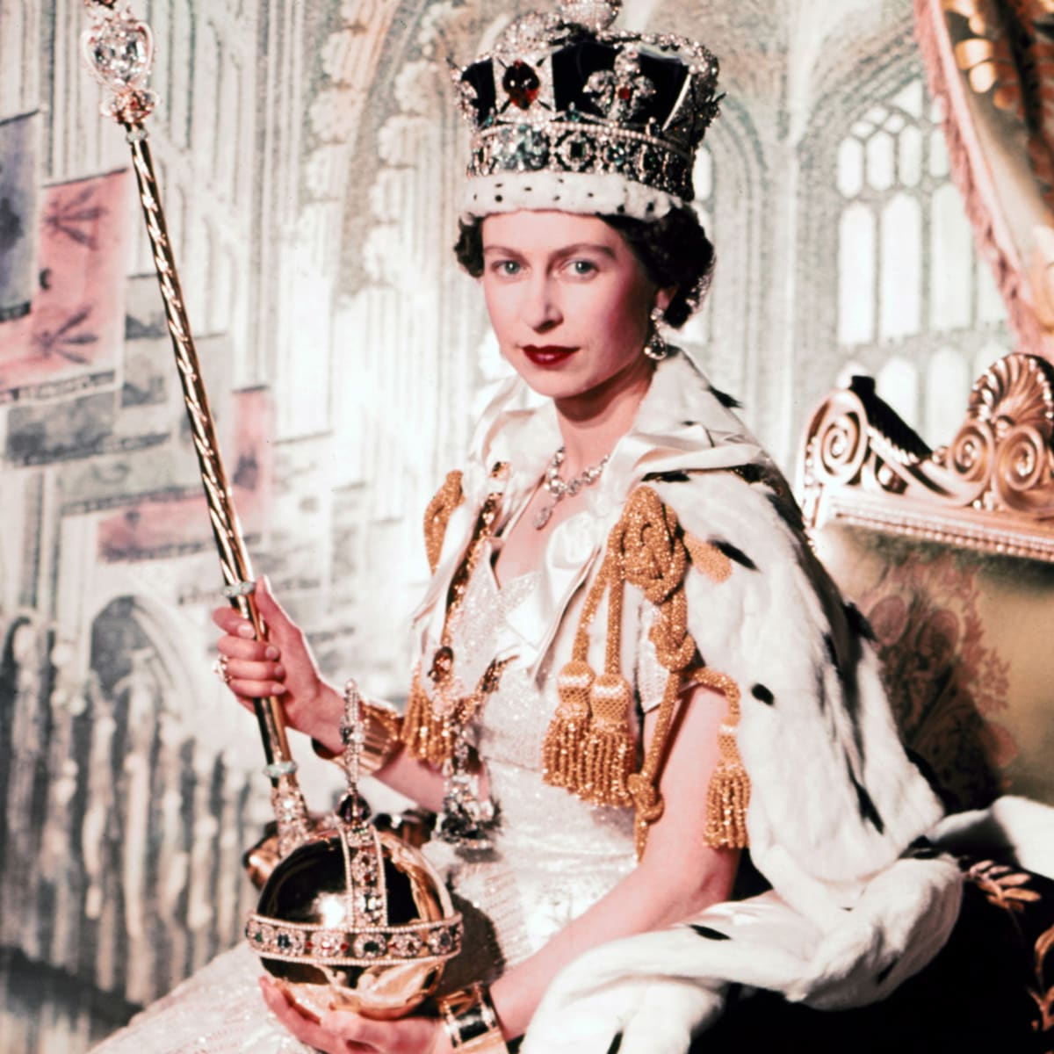
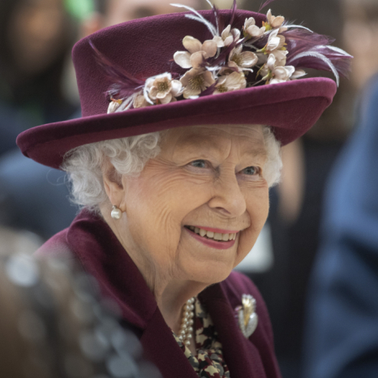
The Queen’s Legacy

Slide 2
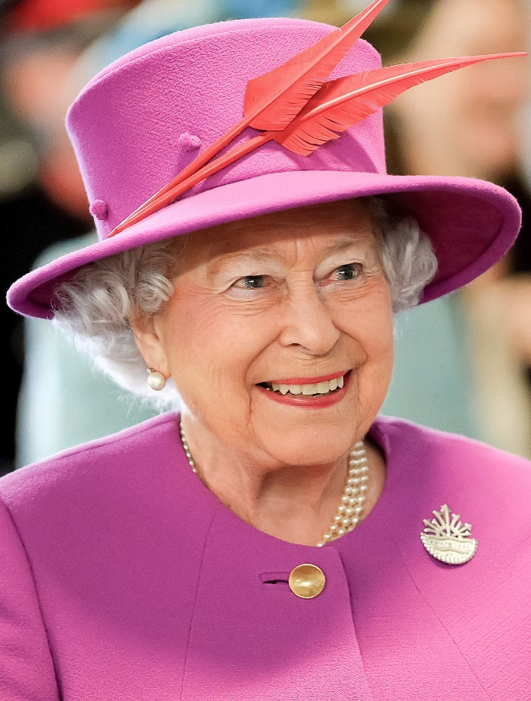
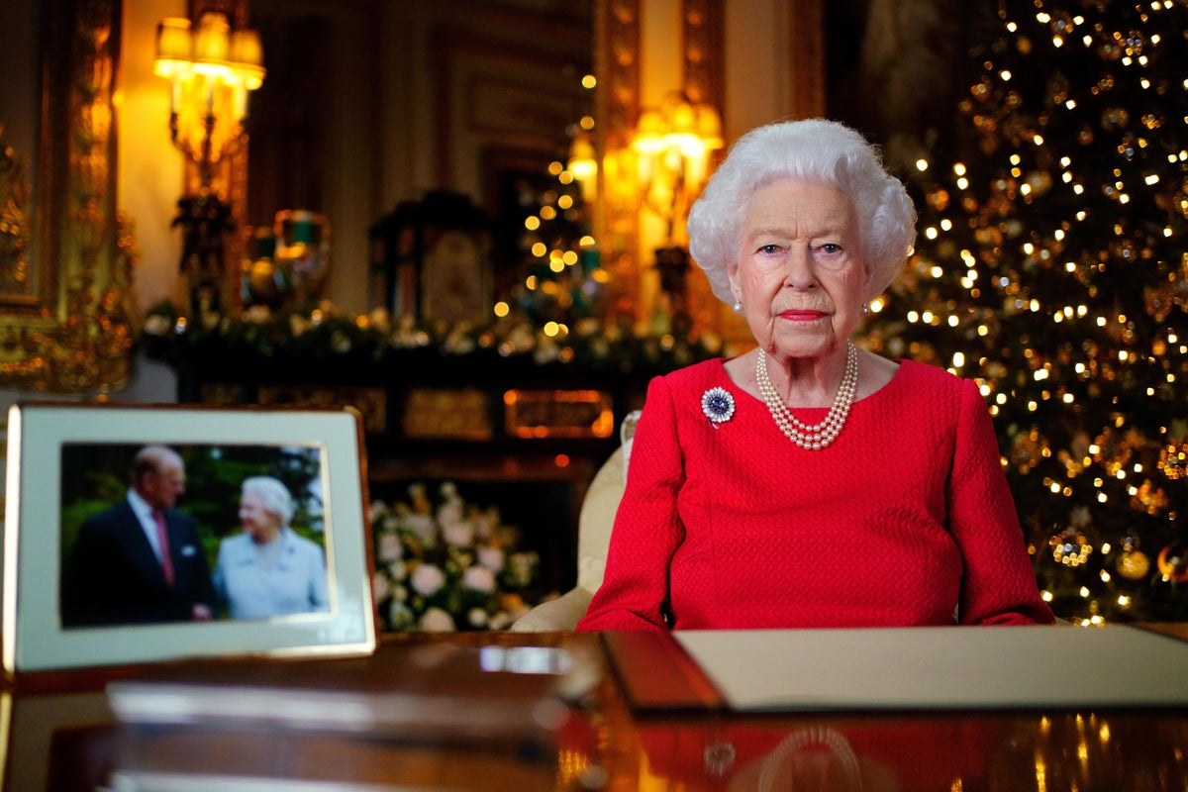

The Queen’s Legacy
True or false?

Slide 3

The Queen’s Legacy
The Queen has two birthdays: her actual birthday is on 21 April and she also has an official birthday in June, when there is better weather.

Slide 4
The Queen’s Legacy
The Queen is the only person in the UK who is allowed to drive without a driving licence.

Slide 5
The Queen’s Legacy
The Queen’s favourite dogs are spaniels.
In fact, her favourite dogs are Corgis.

Slide 6
The Queen’s Legacy
The Queen sent her first email in 1976.

Slide 7

The Queen’s Legacy
What does the word ‘legacy’ mean?

Slide 8
The Queen’s Legacy
A legacy is something that is passed on to the next generation.

Slide 9
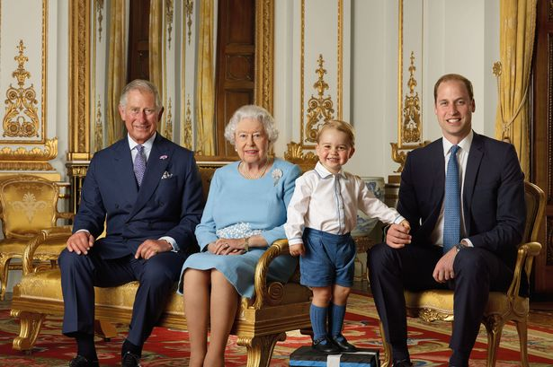
The Queen’s Legacy
Who are these future kings?

Slide 10
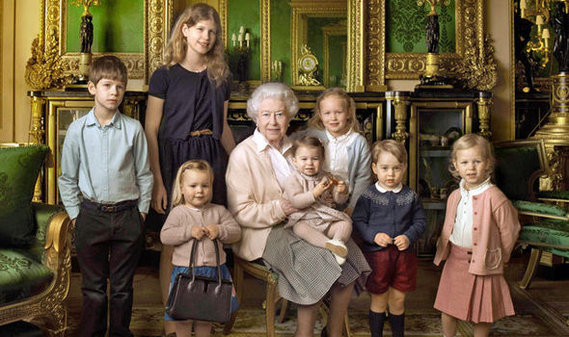
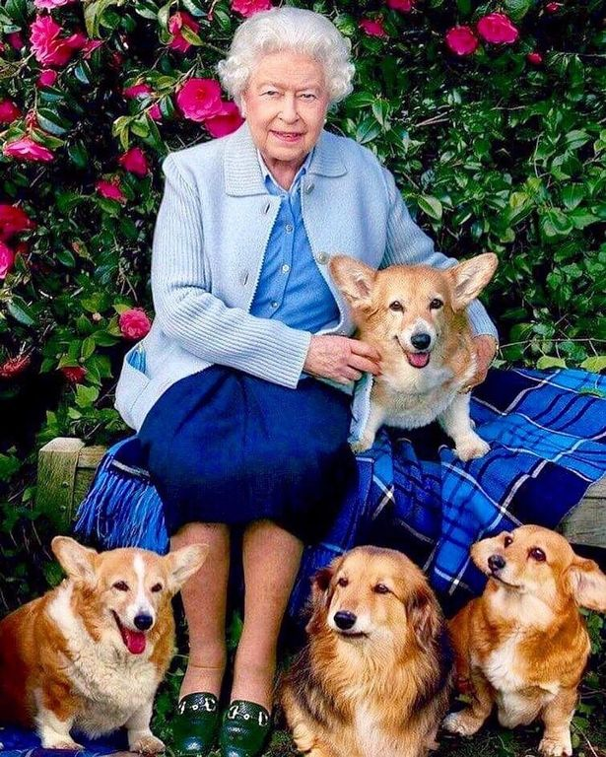
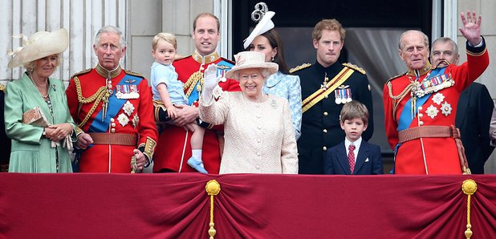
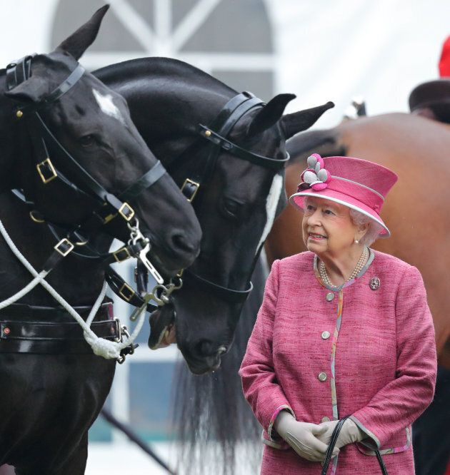
The Queen’s Legacy
How would you describe the Queen?

Slide 11
The Queen’s Legacy
The Queen’s legacy can be described as:
loyal
Constant
Dutiful
How has she managed to maintain this for 70 years?

Slide 12
How has the Queen managed to be
Loyal
Constatnt
Dutiful
For 70 years!!

Slide 13
Her Christian Faith
The Queen understands how important her faith has been during the good times and the bad. The Queen believes in the importance of prayer in her daily life and understands that Jesus was sent to earth to serve, not be served. This is a great way to describe how the Queen sees her role – to serve the country rather than being served by it.

Slide 14
Reflection
Think quietly about the lessons we can learn from the Queen. How can we be loyal and serve be helpful to one another.

Slide 15


The Queen’s Legacy

