Slide 1
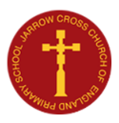
Celebration of Sport Awards
10th July 2024

Slide 2
Multi-skills
Hockey
Tennis
Football
Cheerleading
Gymnastics
Athletics

Slide 3
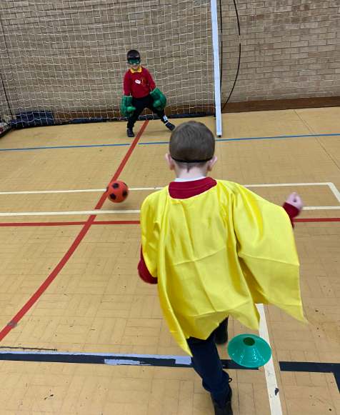
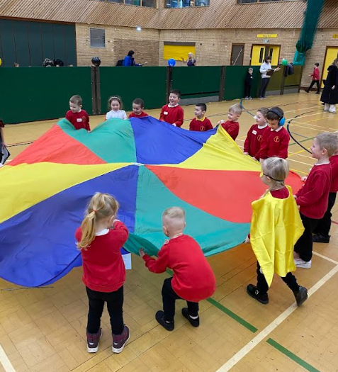
Reception
Megasports

Slide 4
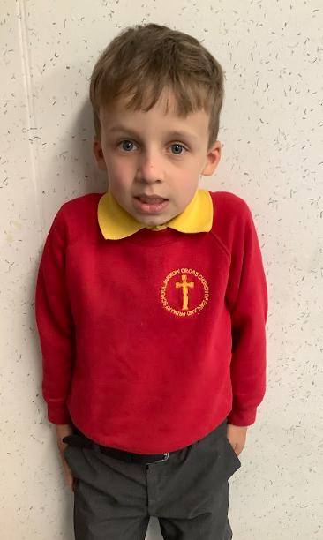
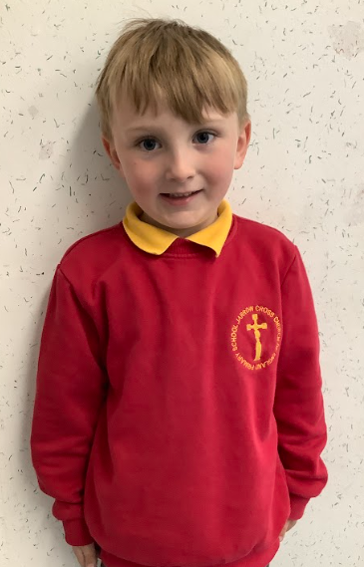
Reception
Megasports
Thomas & Jake

Slide 5
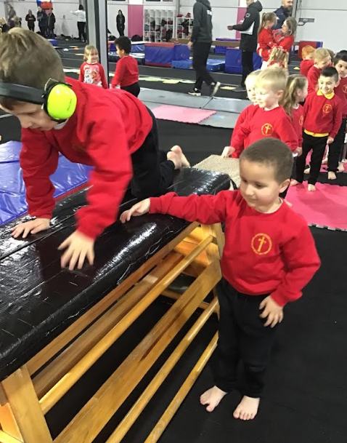
Reception
Gymnastics

Slide 6
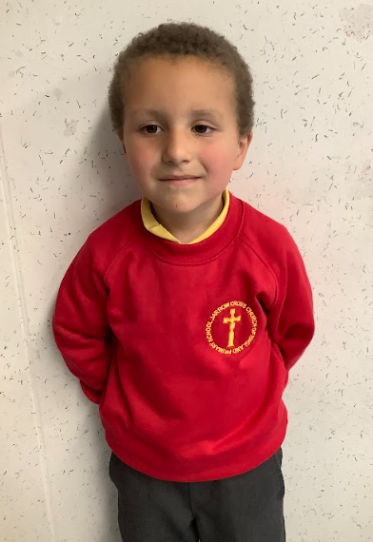
Reception
Gymnastics
Kian

Slide 7
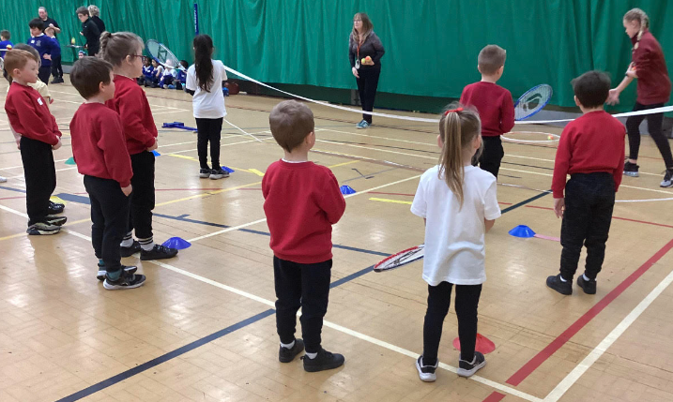
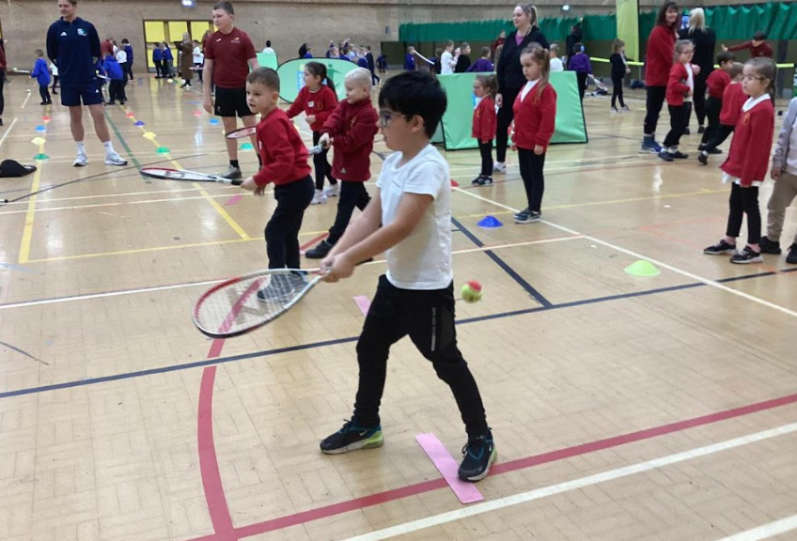
Year 1
Tennis

Slide 8
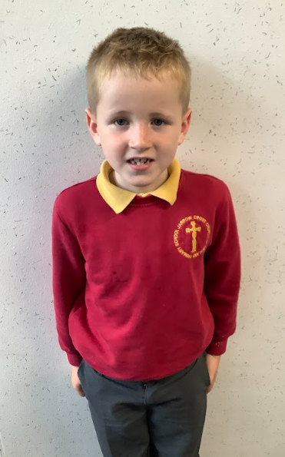
Year 1
Tennis
Harry

Slide 9
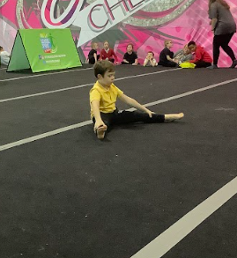
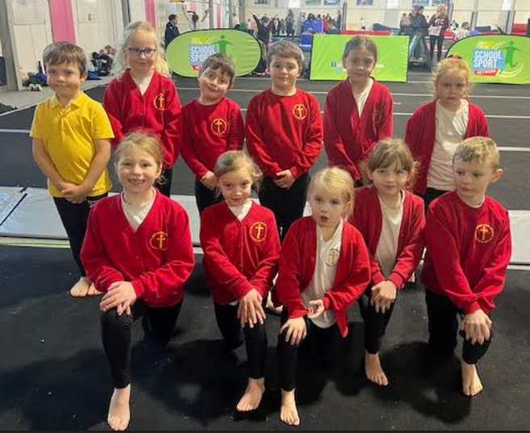
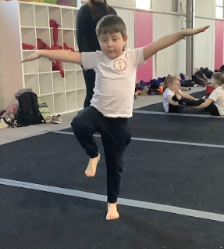
Year 2
Gymnastics

Slide 10
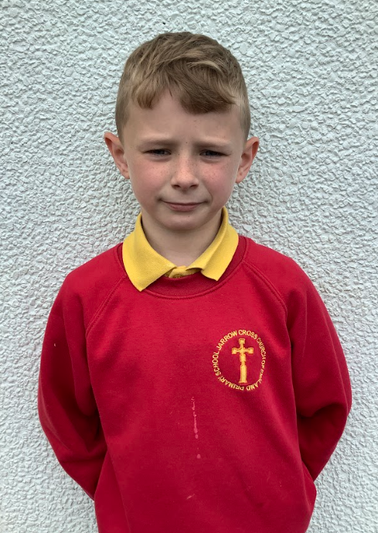
Year 2
Gymnastics
Matthew

Slide 11
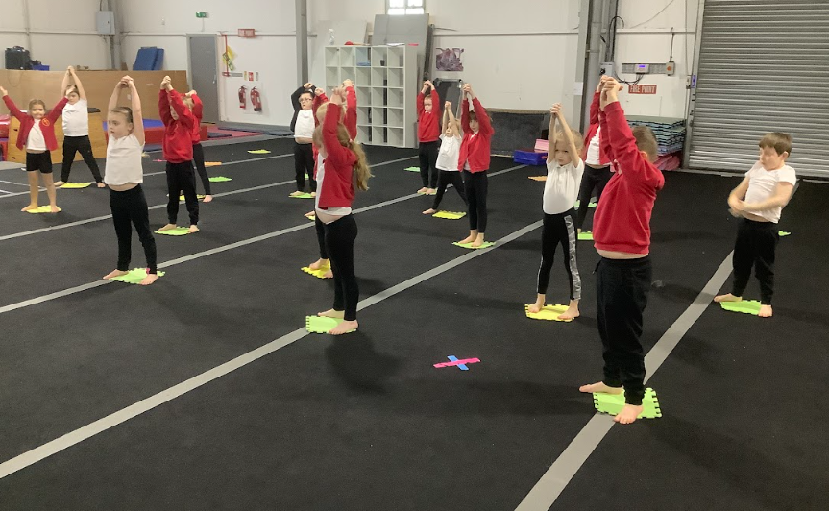
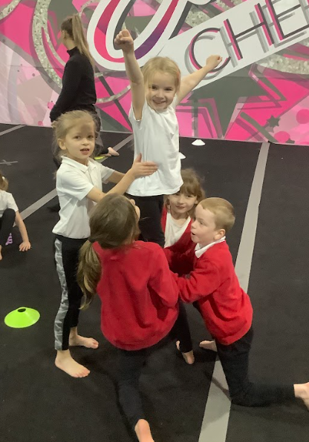
Year 2
Cheerleading

Slide 12
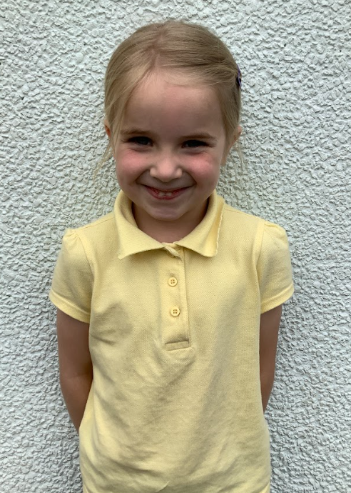
Year 2
Cheerleading
Kaia- Rose

Slide 13
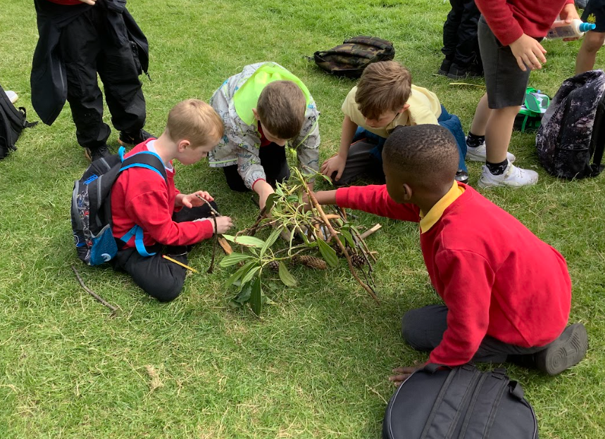
Year 2
Outdoor & Adventurous

Slide 14
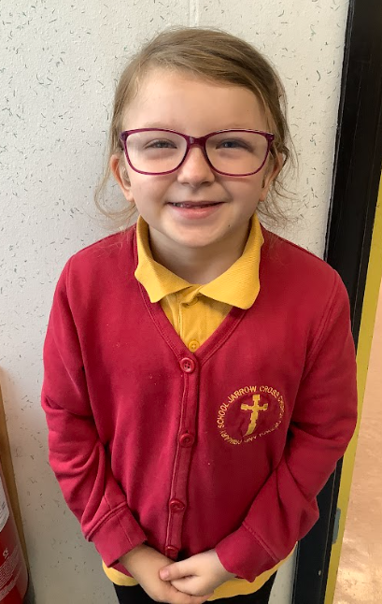
Year 2
Outdoor & Adventurous
Pearl

Slide 15
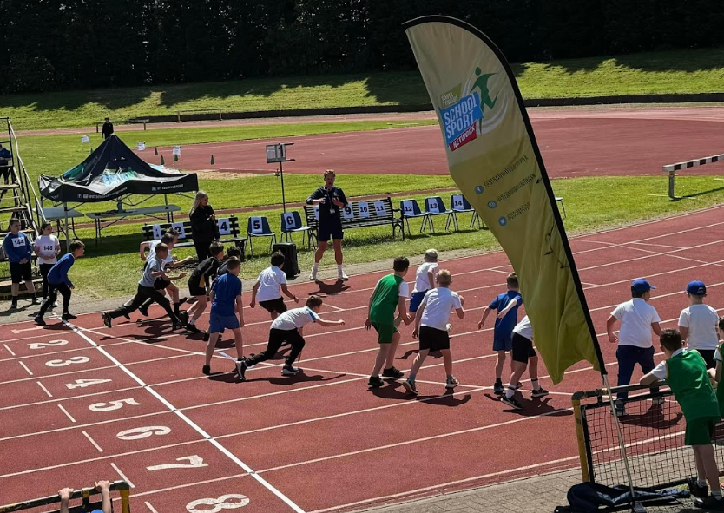
Year 3
Athletics

Slide 16
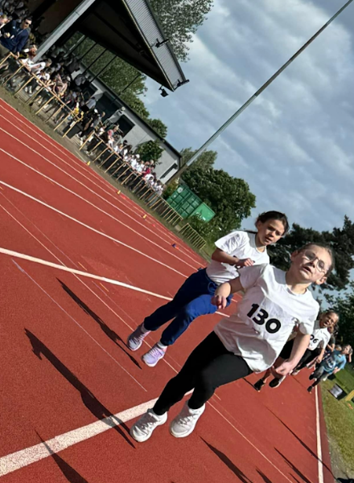
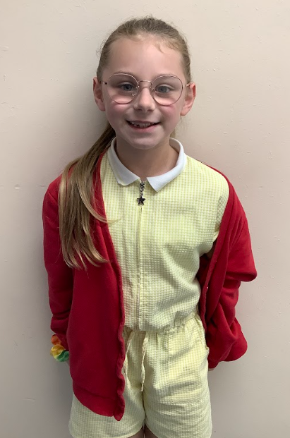
Year 3
Athletics
Olivia

Slide 17
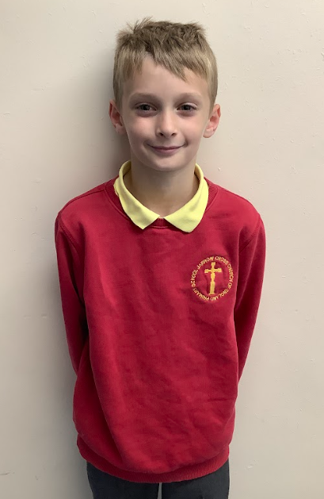
Year 4
Hockey
Riley

Slide 18
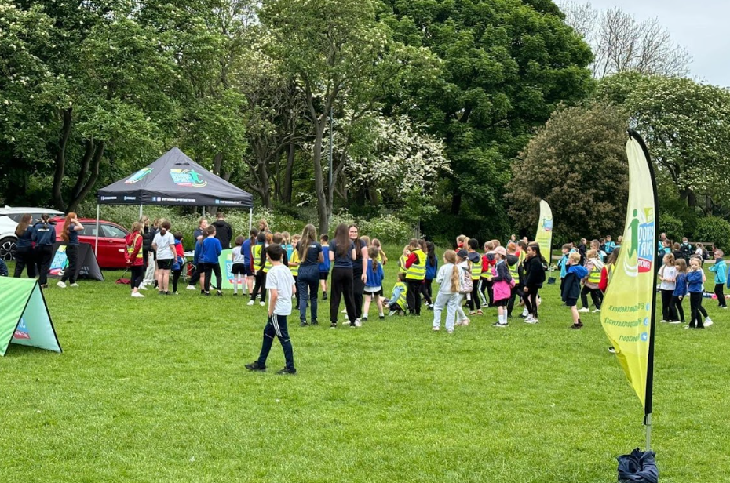
Year 3-4
Outdoor & Adventurous

Slide 19
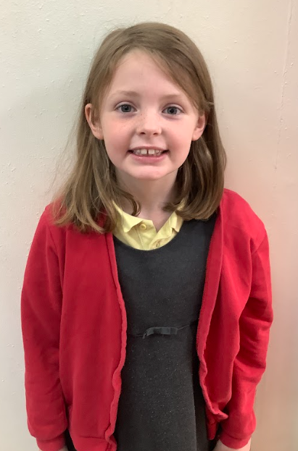
Year 3-4
Outdoor & Adventurous
Olivia

Slide 20
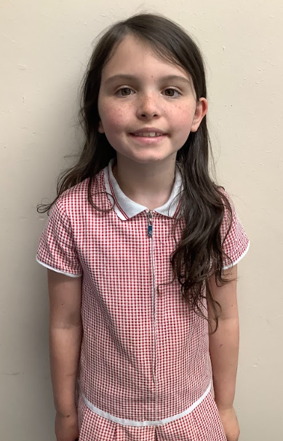
Year 3
Most improved Swimmer
Scarlet

Slide 21
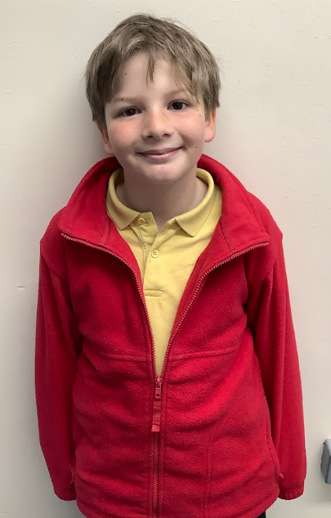
Year 4
Most improved Swimmer
Noah

Slide 22
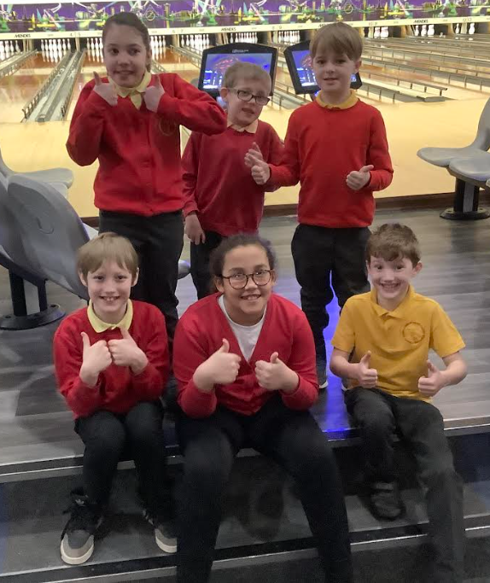
Key Stage 2
Ten Pin Bowling

Slide 23
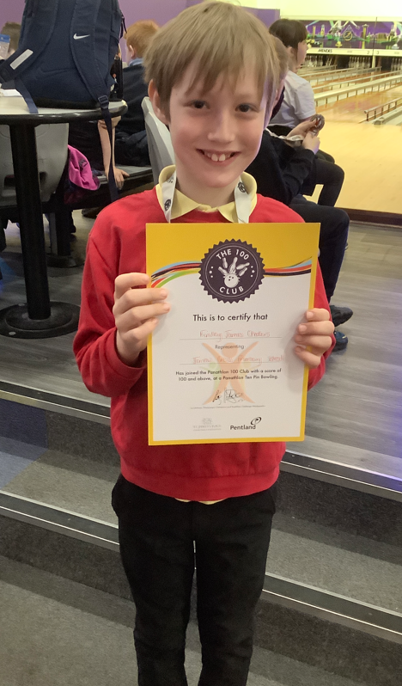
Key Stage 2
Ten Pin Bowling
Finley-James

Slide 24
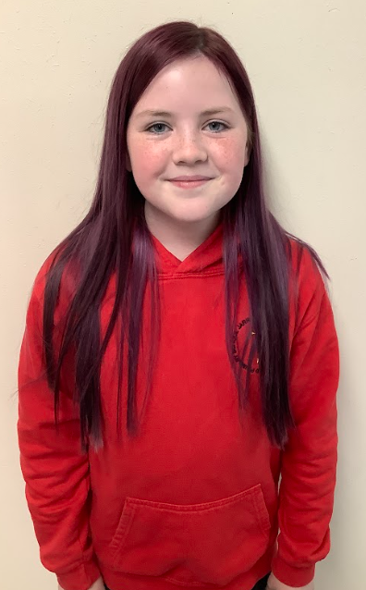
Year 6
Gymnastics
Josie

Slide 25
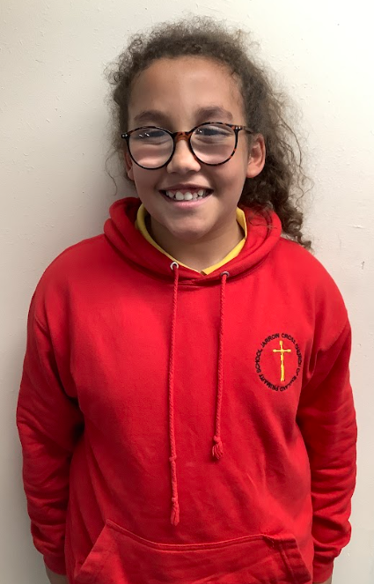
Year 6
Most improved Swimmer
Kaitlyn

Slide 26
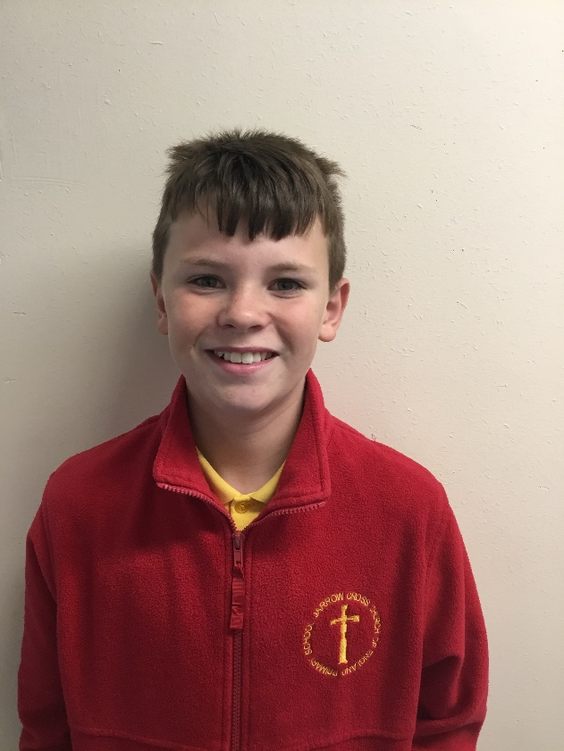
Year 6
Dodgeball
Monty

Slide 27
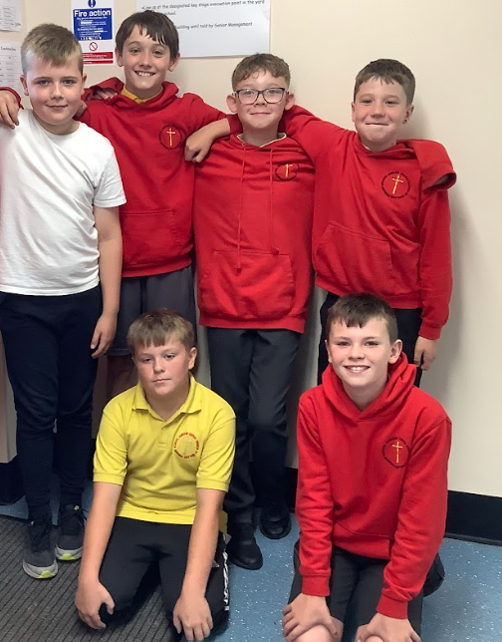
Year 5-6
Boys Football

Slide 28
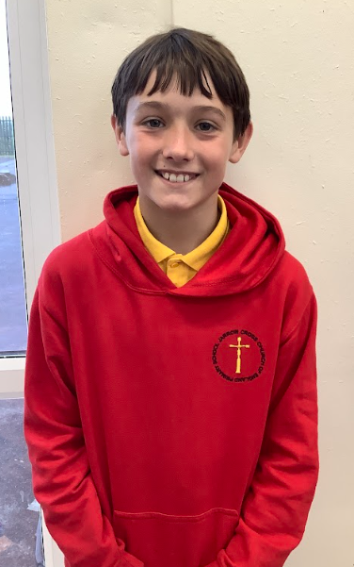
Year 5-6
Boys Football
Max

Slide 29
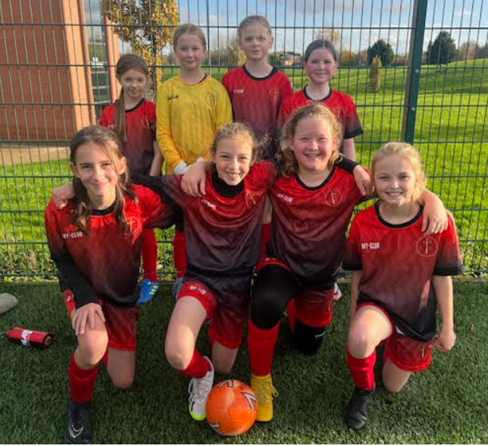
Year 5-6
Girls Football

Slide 30
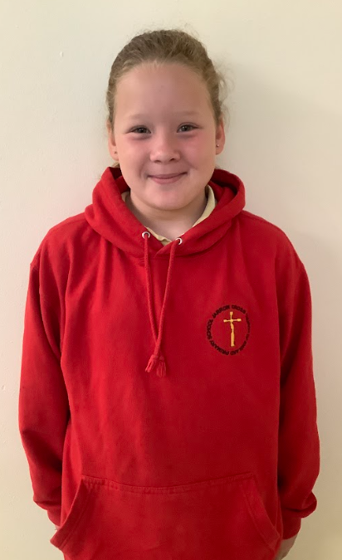
Year 5-6
Girls Football
Ruby

Slide 31
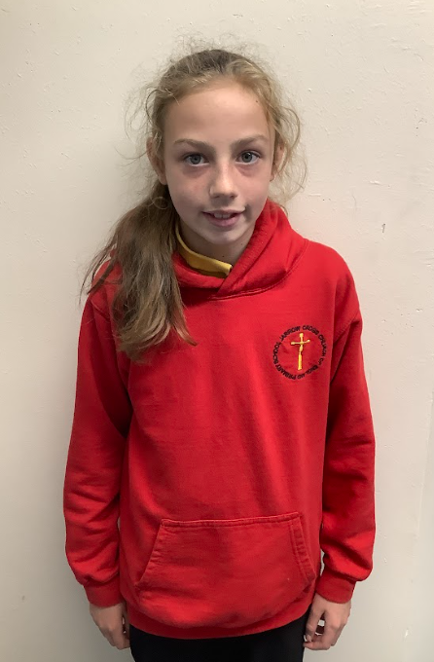
Outstanding Achievement in
Girls Football
Madeline

Slide 32
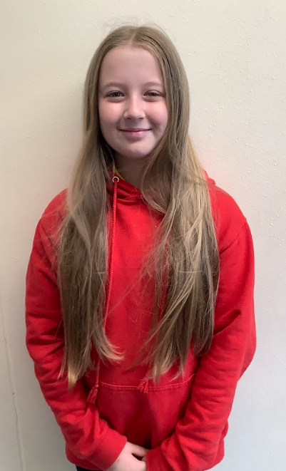
Jarrow Cross
Sports Person of the Year
2024
Ruby

