Slide 1
Year 6 SATs 2025

Slide 2
Dates
Monday 12th May 2025 – Thursday 15th May 2025.
Monday – English grammar, punctuation and spelling, papers 1 and 2
Tuesday – Reading
Wednesday –Mathematics papers 1 and 2
Thursday - Mathematics paper 3

Slide 3
Additional arrangements
Some children may have additional needs, which entitles them to access adapted arrangements during SATs.
If your child is normally part of a small group or has a reader or scribe, this will be provided for them during their SATs.

Slide 4
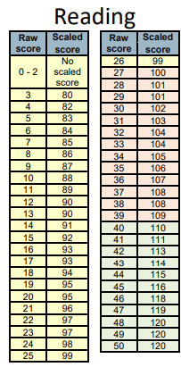
Results
2024 – raw score
Reading
27/50 – Expected
40/50 – Greater Depth
Maths
54/110- Expected
93/110- Greater Depth
EPGS
35/70- Expected
53/70- Greater Depth
Reading 2024
Raw score relates to the number of marks your child scores on the test.
This is then converted to a scaled score.
A scaled score of 100 means your child has reached the expected standard.
A scaled score of 110 indicates that the child is working above the expected standard and has achieved greater depth.
The required raw score for 2025 is not released until after the children’s results.

Slide 5
How to support at home
READING
Give/explain the meaning of words in context
Retrieve and record information/identify key details from fiction and non-fiction
Summarise main ideas from more than one paragraph
Make inferences from the text/explain and justify inferences with evidence from the text
Predict what might happen from details stated and implied
Comment on the use of vocabulary
Make links/ comparisons within the text
Home reading /pace
Reading plus
Reading for pleasure

Slide 6
How to support at home
EGPS (English Grammar, Punctuation and Spelling)
Paper 1 – Punctuation, grammar, vocabulary, technical rules of writing.
Grammatical terms/word classes
Functions of sentences
Combining words, phrases and clauses
Verb forms, tenses and consistency
Punctuation
Vocabulary
Standard English and formality
Paper 2 – Spelling test. Year 5/6 word list + 3/4 word list
Studyzone
Spag.com
Oxford owl

Slide 7
How to support at home
Maths
Paper 1 Arithmetic –
4 operations, fractions, decimals, percentages
Papers 2 and 3 - Reasoning
Number and place value
Addition, subtraction, multiplication and division (calculations)
Geometry – properties of shapes
Geometry – position and direction
Statistics
Measurement
Algebra
Ratio and proportion
Fractions, decimals and percentages
Times table rock stars
Homework
Hit the button
Intervention groups
Fluency
Problem solving
Reasoning

Slide 8

How to support at home

Slide 9
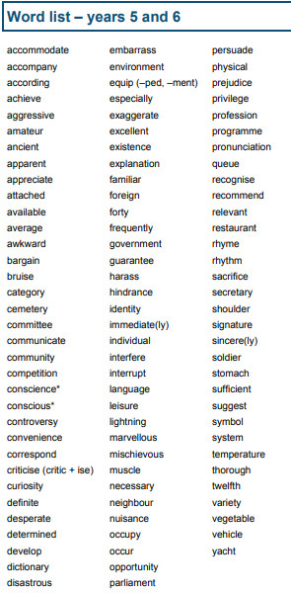
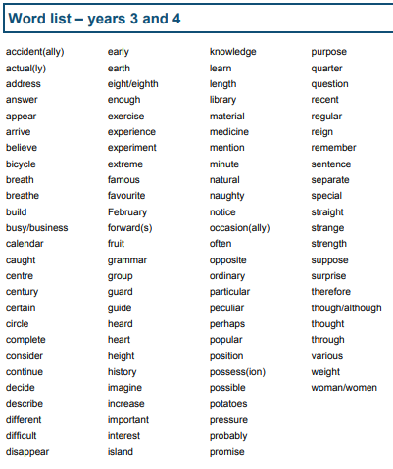

How to support at home

